Slide 1
Travel Planner Agent
CAPSTONE PROJECT
Presented By:
-Ansh Sharma
-Manipal University Jaipur
-Information Technology

Slide 2
OUTLINE
Problem Statement
Proposed Solution
Technology Used
Wow factor
End user
Result
Conclusion
Git –hub Link
Future Scope
IBM Certifications

Slide 3
Problem Statement
Travel Planner Agent :
Currently, AI-powered travel planning assistants are transforming the way people organize and enjoy their trips. With the growing demand for personalized and efficient travel solutions, it is important to offer travelers accurate and timely recommendations to enhance their overall journey. Providing destination suggestions, tailored itineraries, and suitable transportation or accommodation options at the right moment greatly improves convenience and satisfaction. Ultimately, ensuring that travelers receive reliable, real-time guidance becomes a key challenge. The crucial part lies in leveraging intelligent systems to process user preferences, budgets, and constraints, enabling the creation of seamless and memorable travel experiences.

Slide 4
Proposed Solution
Personalized Travel Planning – Create a user profile capturing preferences, budget, travel dates, and interests.
Real-Time Data Integration – Pull up-to-the-minute information on destinations, transport schedules, accommodation availability, weather, and local events.
Custom Recommendations – Suggest relevant destinations, itineraries, transportation options, and lodging tailored to each user.
Adaptive Itinerary Management – Monitor flight delays, weather changes, and cancellations, and update plans instantly to reduce disruptions.
Predictive Assistance – Use recommendation systems and predictive modeling to anticipate user needs before they arise.
Seamless Platform Integration – Integrate with booking services, maps, and local guides for smooth trip planning and execution.
Data Privacy & Security – Implement strict measures to secure user data and use it solely to enhance the travel experience.
End-to-End Support – Provide continuous assistance, from trip inspiration to final itinerary management, ensuring a safe, efficient, and enjoyable journey.

Slide 5
Technology used
Watsonx.ai
Agent lab
IBM Cloud lite services
IBM Granite
Natural Language Processing (NLP)
Retrieval Augmented Generation (RAG)

Slide 6
Ibm cloud services used
IBM Cloud Watsonx AI Studio
IBM Cloud Watsonx AI Runtime
IBM Cloud Agent lab
IBM Granite foundation model

Slide 7
Wow factors
The AI-powered Travel Planner Agent streamlines the entire travel planning process by delivering real-time, personalized recommendations. It reduces planning time, improves itinerary quality, and ensures seamless, memorable journeys for all travelers.
Unique Features:
Personalized Itineraries based on user preferences, budget, and timing.
Dynamic Recommendations for destinations, attractions, and accommodations.
Real-Time Alerts & Auto-Adjustments for weather, transport, and events.
Integrated Bookings for flights, hotels, and activities.
Budget Tracking with cost-saving suggestions.
Trend Insights on popular and emerging destinations.
Group Planning Tools for shared itineraries and coordination.
24/7 Multilingual Support for global assistance.
This assistant automates research and logistics so travelers can focus on experiences, not planning.

Slide 8
End user
Travel Agencies & Companies
Individual Travelers
Students
Group Travelers
Corporate Travel Managers

Slide 9
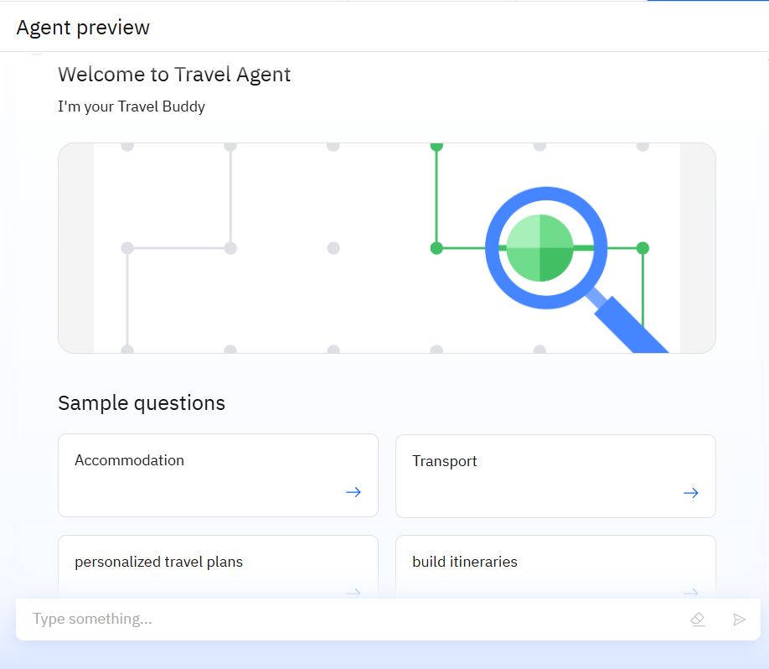
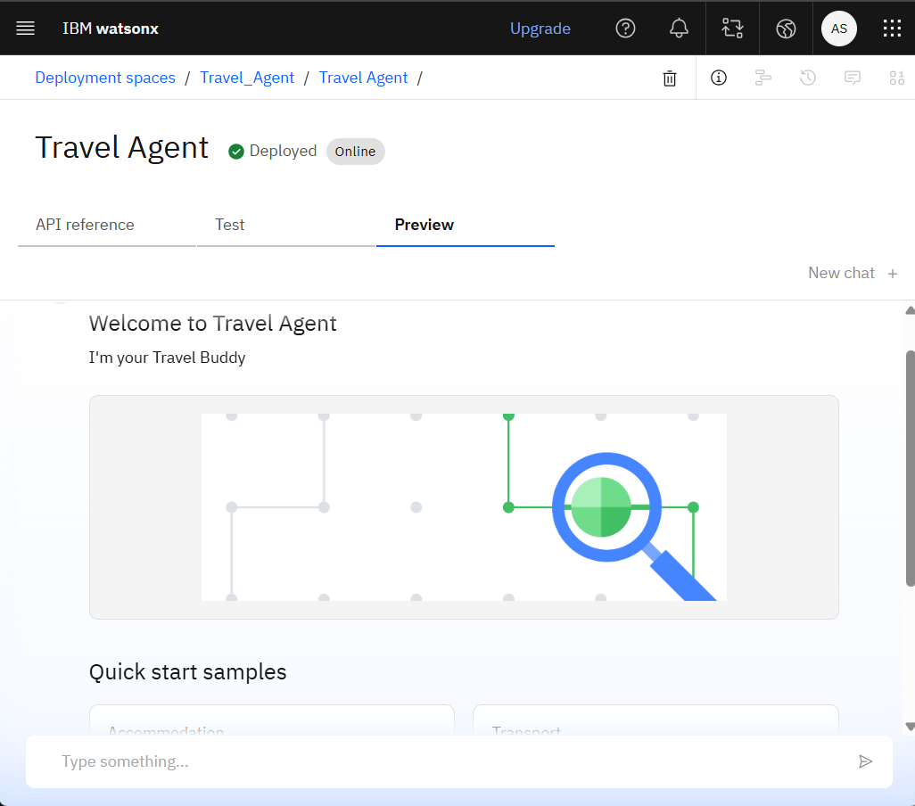
Result
INITIAL LOOK
DEPLOYED AI AGENT

Slide 10
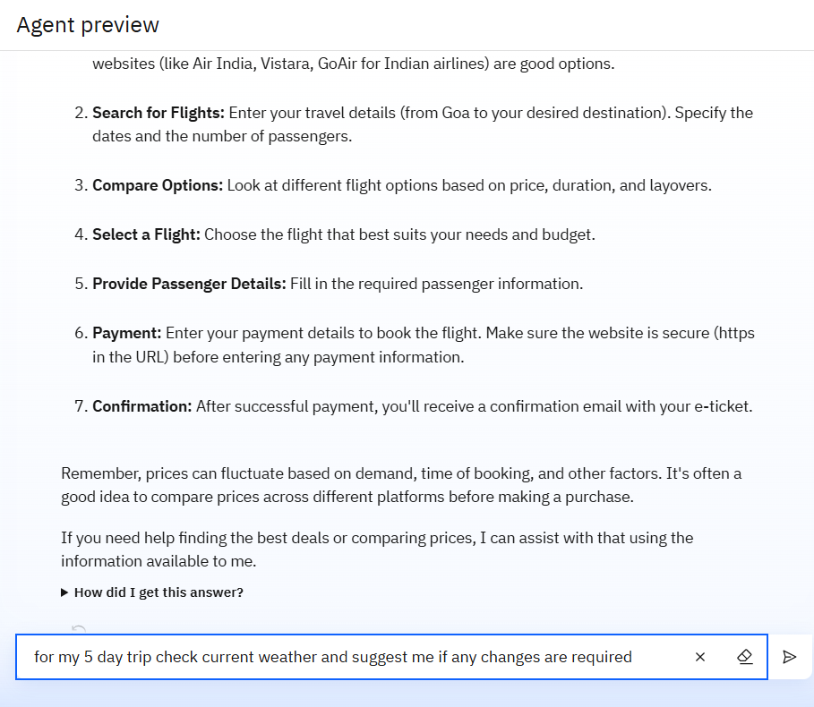
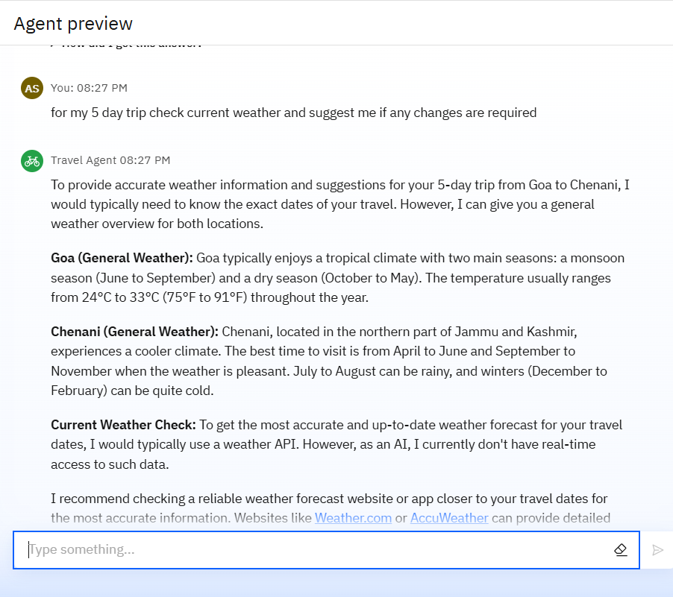
Result
WEATHER INTEGRATION

Slide 11
Conclusion
The AI-powered Travel Planner Agent serves a diverse range of end users—from solo travelers and groups to corporate clients and travel agencies—making it a highly versatile solution.
By tailoring recommendations and automating trip organization, it delivers a highly efficient, stress-free planning experience for every user type.
Whether for leisure, business, budget, or luxury travel, the agent enhances convenience, saves time, and ensures a seamless, enjoyable journey for all.

Slide 12
Git – hub link
https://github.com/ANSH-SHARMA912/IBM-TRAVEL-PLANNER-AGENT.git

Slide 13
Future scope
Enhance recommendation accuracy by integrating advanced vector indexing techniques to better understand user preferences and travel content similarity.
Leverage IBM Cloud’s scalable infrastructure to support real-time processing of larger datasets and more complex machine learning models for personalized trip planning.
Expand data sources by incorporating user-generated content such as reviews, social media, and local insights for richer travel recommendations.
Implement multi-modal capabilities using IBM’s AI services to provide recommendations through voice, image recognition, and chat interfaces.
Develop predictive analytics to forecast travel trends, demand, and pricing fluctuations, enabling proactive itinerary adjustments and cost savings.
Integrate with IoT and smart city data on IBM Cloud to provide hyper-localized travel experiences, such as real-time transport availability and crowd predictions.
Enhance privacy and security features leveraging IBM Cloud’s robust governance and compliance tools to build user trust.
Explore seamless integration with other IBM Cloud AI services like Watson Assistant for improved conversational experiences and Watson Discovery for intelligent querying of travel data.

Slide 14
References
Google
YouTube
Mentor led Secessions

Slide 15
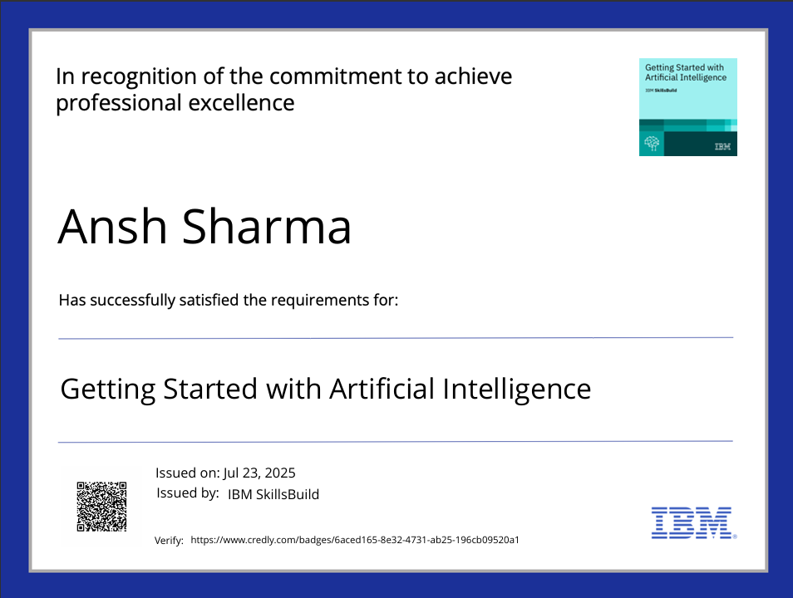
IBM Certifications

Slide 16
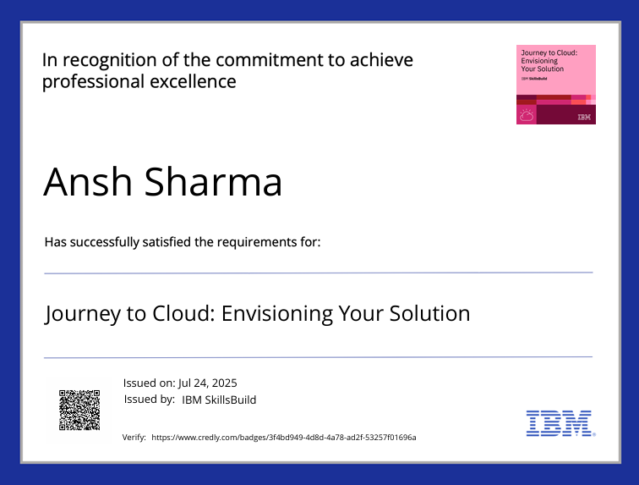
IBM Certifications

Slide 17
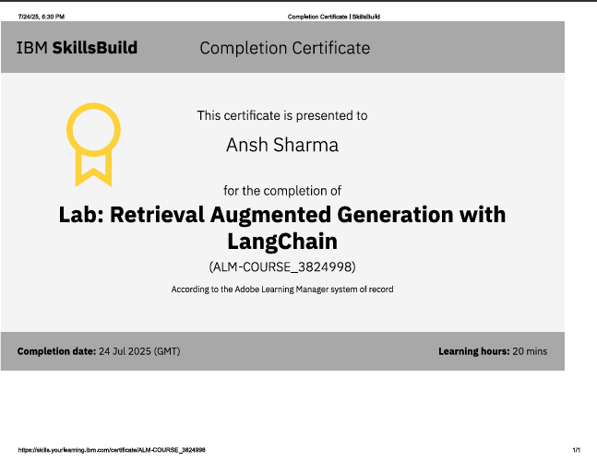
IBM Certifications

Slide 18
THANK YOU

